Slide 1
**Only informative slides have been reproduced here**

Slide 8
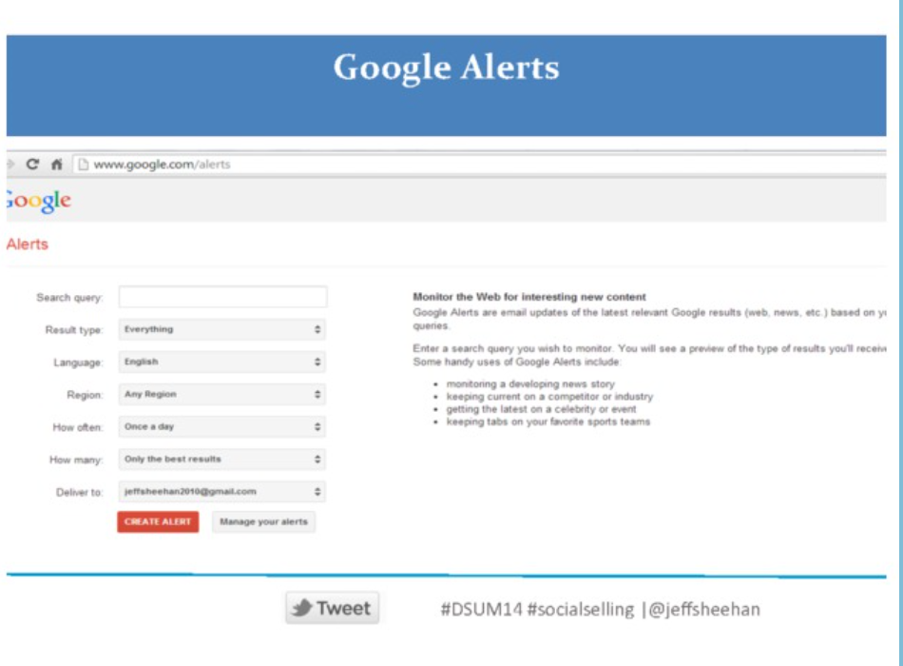

Slide 10
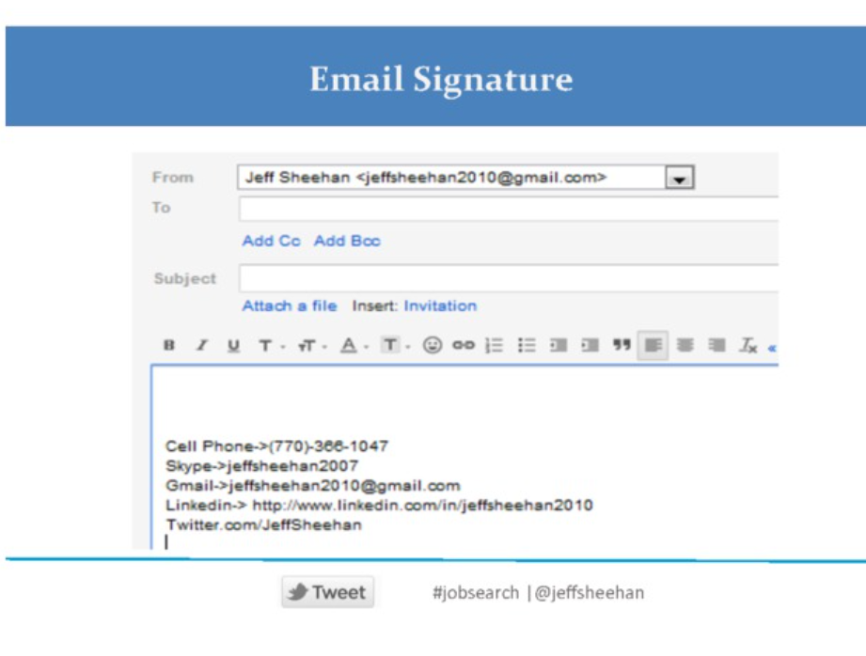

Slide 17
