Slide 1
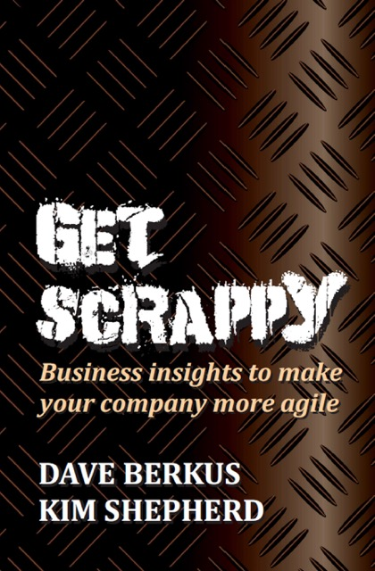
Helping Career Changers & Job Seekers Find Their Sweet Spot: The Intersection Between Culture & Talent
Presented
November 9, 2016
Kim Shepherd
@KimShepherd_DT
kshepherd@dtoolbox.com
Notes:
Next: Kim’s bio

Slide 2
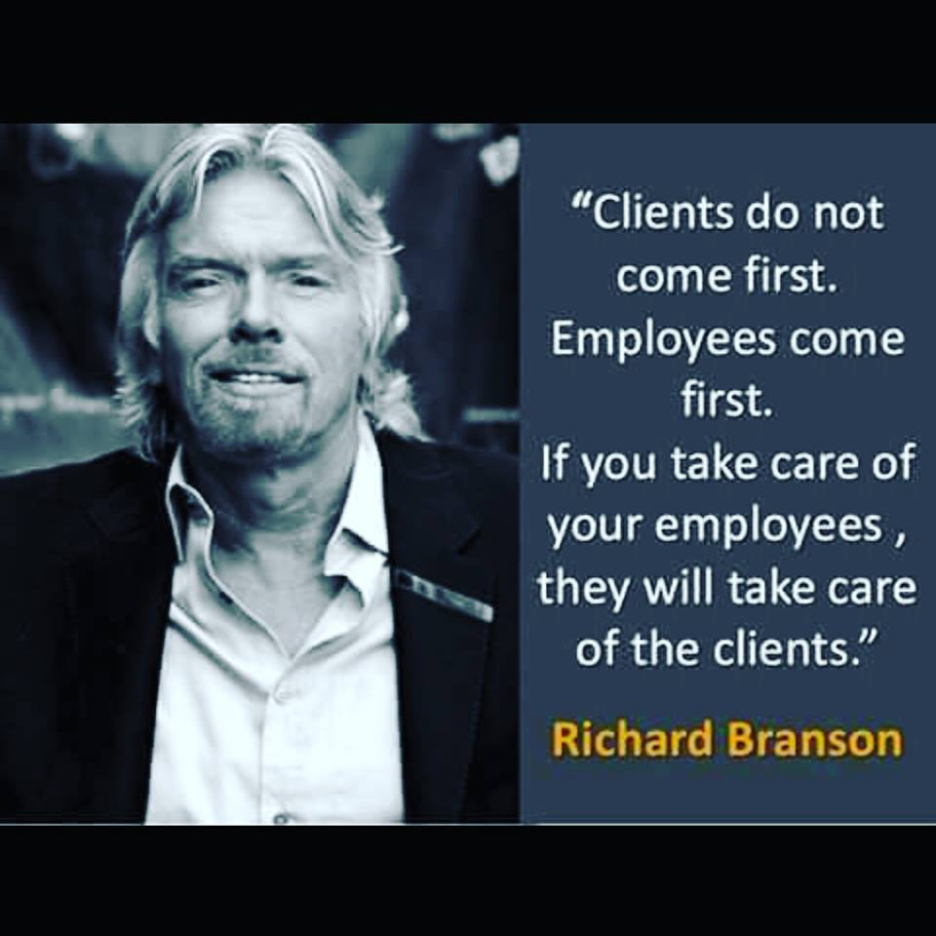
Notes:
Next: Me Inc

Slide 3
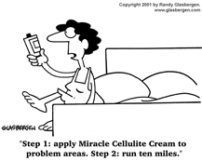
“There is nothing common about common sense”.
~ Kim Shepherd
Notes:
Next: Me Inc

Slide 4
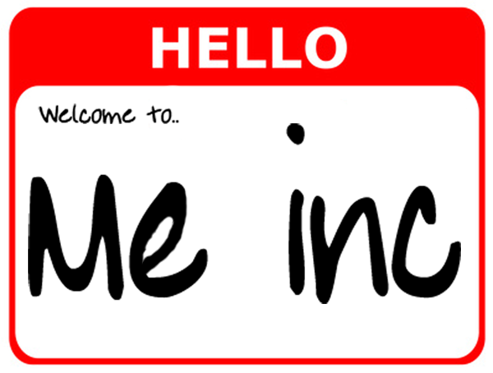
Cultural Shift
Notes:
Next: Big Rocks

Slide 5
Work-Life LIFE Balance

Slide 6
The “Big Rocks” Theory
First Things First – Stephen Covey
Identify your Big Rocks and tackle those first
Small rocks can suck up time and space!
Company culture = a BIG rock
Notes:
Next: Design what you want

Slide 7
Design what you want… or deal with what you get!
Clarity
Implementation
Outcome
TIME
Notes:
Next: Respect/Trader Joe’s

Slide 8
Great Culture Starts with R-E-S-P-E-C-T
Notes:
Next: Sit or Sing – Respecting Time

Slide 9
Sit or Sing!
Time Management (noun):
Dictionary.com: “the analysis of how working hours are spent and the prioritization of tasks in order to maximize personal efficiency in the workplace”
Time Management (verb):
Kim Shepherd: “Respect”
Notes:
Next: Lincoln logs

Slide 10
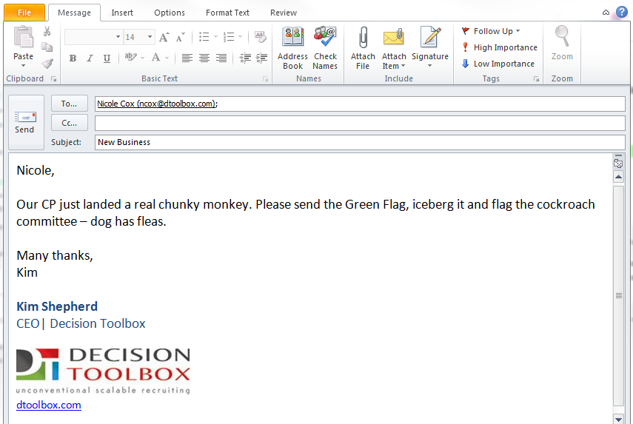
Great Culture is Fluent Tribal Speak
Notes:
Next: Add glue(DT sticky factors– Flash, wellness program, philanthropy challenge)

Slide 11
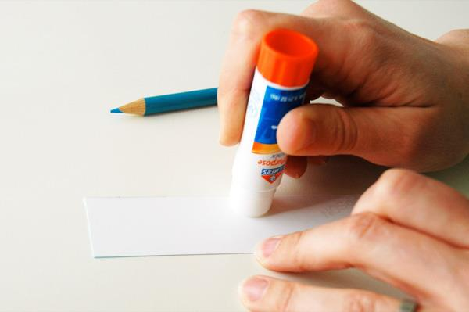
DT Sticky Factors
News Flash
Tiger Teams
Pods
Cockroach Hunting
Yearly All Staff Meeting
Egg Timer
Green Flag
Tsunami Planning
Virtual Water Cooler
Mascara Management
Notes:
Next: Even bricks & sticks are virtual – thanks to technology

Slide 12
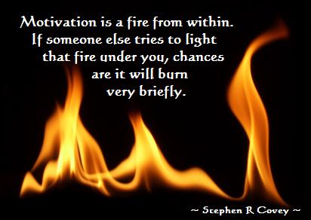
Great Culture Hires Right
Then Lets Go
Tips for Hiring Success:
Evaluate for the right cultural fit
Hire people smarter than you
Empower them
Get out of the way
Notes:
Next: Loren’s business cards & Joanna’s farewell party

Slide 13
Great Culture Builds Exponential Energy
Small Sparks Can Ignite Giant Passion
Involve the team in great moments to gain exponential energy.
Decision Toolbox Examples:
Publically announced promotions
Surprise Farewell Party
Notes:
Don’t fear Mistakes – Boo Boo Award

Slide 14
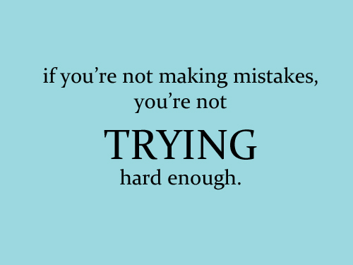
Great Culture Doesn’t Fear Mistakes
Mistakes are an excellent learning opportunity….. embrace them!
Decision Toolbox Example:
Boo Boo of the Month Award
Notes:
Next: Onboarding

Slide 15
Great Culture Welcomes Like Family
Ready Day 1
Welcome Package
Multiple touches by management
Set up employee in advance of start date
(Phone, email, logins)
Notes:
Next: Head vs. Heart & PIECE it together

Slide 16
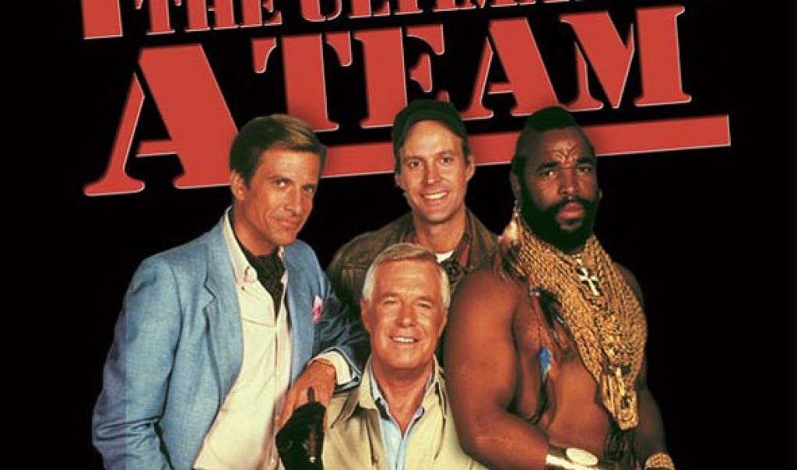
Attract A Players There is No Plan B

Slide 17
JOB RICH
CANDIDATE RICH
TALENT DROUGHT
NEW MEDIA

Slide 18
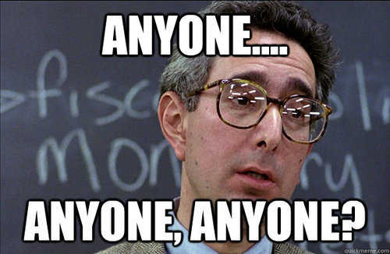
TOOLS
TECHNOLOGY
PEOPLE
Recruiters
Researchers
Marketing/Writers
Project Management
Social Media
Advertising

Slide 19
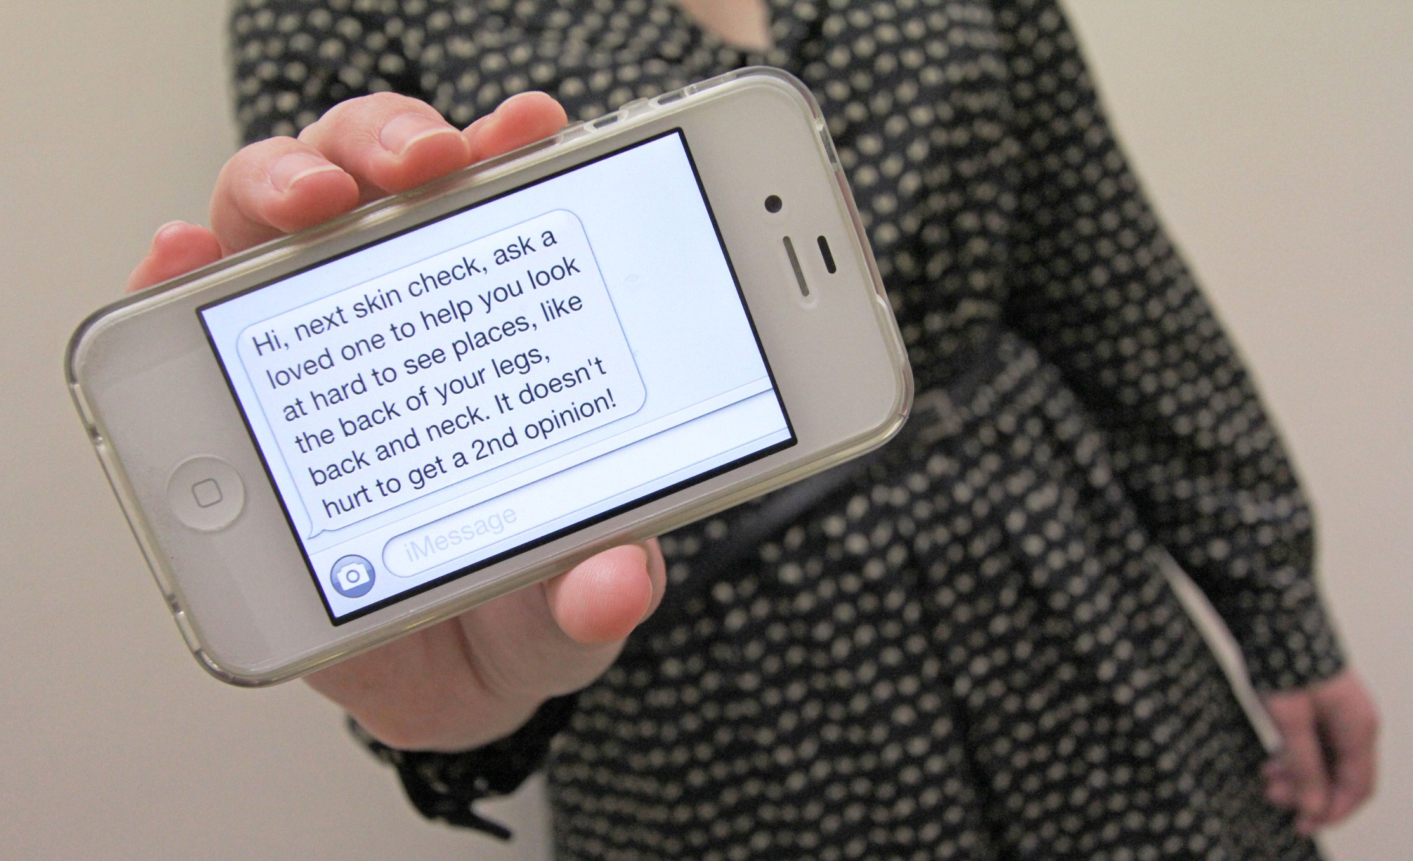
Really enjoyed meeting you and would be honored to have you as a part of the team. I’ll call you shortly to get your thoughts.
TOOLS
TECHNOLOGY
PEOPLE
Recruiters
Researchers
Marketing/Writers
Project Management
Social Media
Advertising

Slide 20
Great Culture PIECES it Together
P
I
E
C
E
Passion
Integrity
Ethics
Compassion
Empathy
Notes:
Next: Italian Parable

Slide 21
An Italian Parable…
Creativity… the difference between being a MANAGER and a LEADER
Notes:
Next: Chicken and Pig

Slide 22
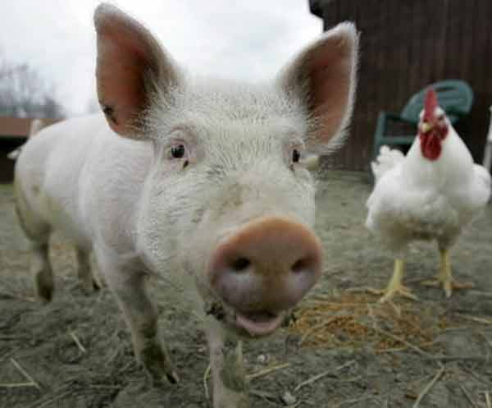
Great Culture Takes Commitment
Notes:
Next: The End – Punch above your weight

Slide 23
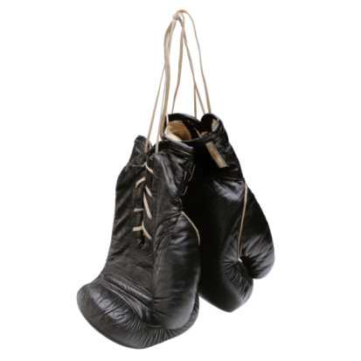
“Impossible is merely an opinion”
Punch above your weight!
Kim Shepherd
kshepherd@dtoolbox.com
949.281.6428

