Slide 1
HARNESS YOUR POTENTIAL
Logo
Notes:
WE NEED A LOGO HERE

Slide 2

WELCOME TO “HARNESS YOUR POTENTIAL”
Creating and Attracting the Life
You’ve Always Wanted
and Never Knew How.

Slide 3
My Goal Is To Teach You the #1 Tool To Creating And Attracting The Life You Long For

Slide 4


Slide 5

Potential
Existing in Possibility

Slide 6
Unforgettable Knowledge
#1 Secret to Attracting & Create a Career You Deserve.
The Essential Tool to keep Moving Forward Even During the Hardest of Times.
The Formula for Sustaining Your Progress
Notes:
After Today

Slide 7

YOU’RE GOING TO WANT MORE
Notes:
Want to see the need for this – Something special for you.

Slide 8
What Makes This So Different?
Its so simple your child can do it.
Experiential learning.
It’s from the inside out!
Notes:
In the webinar – they will take a minute and write a dream – what is that they will do. Will interact - Experiential Learning – Think it and share - Doing something. Taking a step forward - Not judge, or say just to hear it.

Slide 9

Gina Yarrish
National Recognized #1 Bestselling Author
Highly sought after Motivational Speaking
Top Experiential Life Coach with Equine Partners
Multi Entrepreneur of Success

Slide 10

Life Didn’t Start Out Like Most
Born in an unwed mothers home
Poor choices
Left friends behind
Worked 24/7
Felt very alone

Slide 11

Finally Figured It Out
Notes:
Living life by default – and over an over again.

Slide 12
Without College
Entrepreneur in Real Estate for over 25 years.
National Recognized Published Author
Highly Sought after Motivational Speaker
Equine Practitioner and Equine Specialist of Physiotherapy
Certified Life Coach
Happily Married 26 years. 4 Amazing Children, 2 are Chosen Children.
30 Day Vacations
Notes:
GINA NOTE - Might consider turning this into two slides with pictures

Slide 13
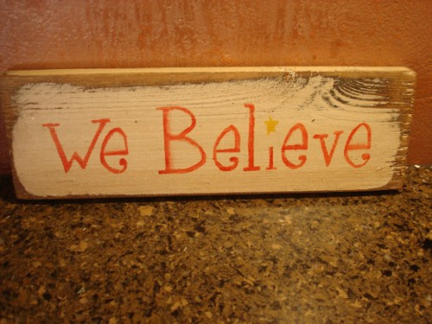
After Doing This For Over 10 years
Nothing is outside my reach
everything I need is within me
When I changed, the world
around me changed in my favor
Notes:
What I Discovered in the Processes

Slide 14
The HARD WAY Really Isn’t So Hard.
Notes:
We make it hard

Slide 15

What Will Hold You Back- The Hard way!
Worker harder and longer, 24/7
The only one that knows how
Easier to do it yourself
Self doubt and worry
Excuses

Slide 16

How Long Have You Tried ?
Notes:
How long have you tried and what have you tried. I want this and really excite me.

Slide 17

The Easy Way Is To Focus On You!

Slide 18

I Worked 24/7, and Spend my life fixing everything for everyone and doing for everyone that It Nearly Killed Me…
I Didn’t Let It

Slide 19
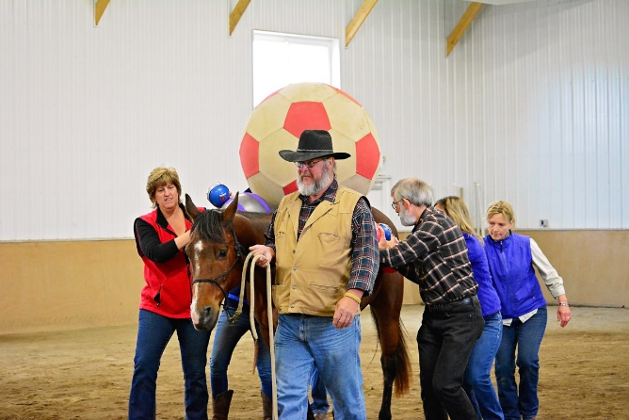
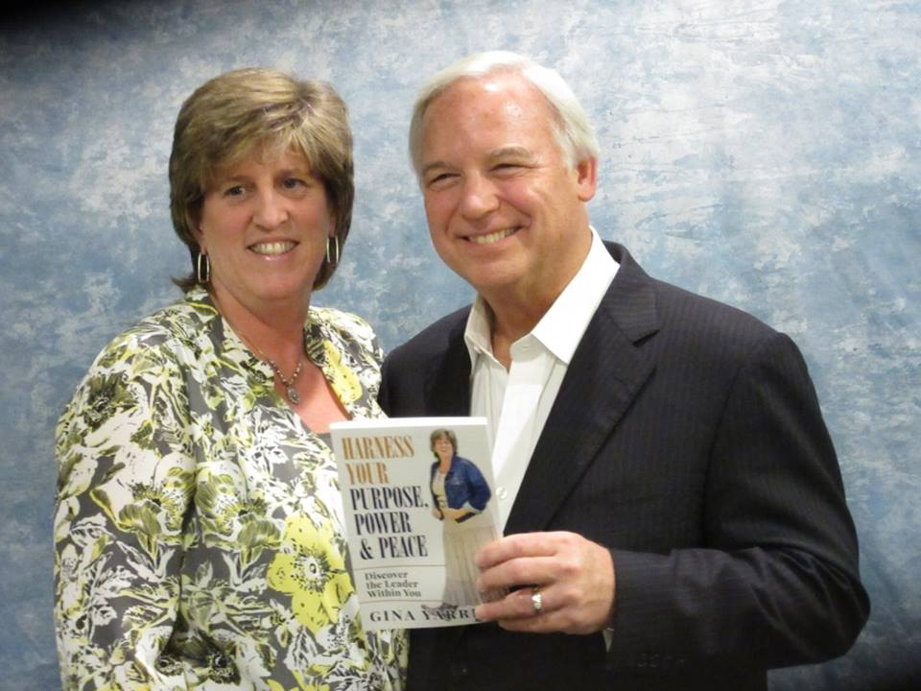

RESULTS ARE NOT TYPICAL…
Notes:
I just took a 30 Day vacation, meet the most amazing people like Jack Canfield and I am living the ultimate dream job with with my husband and family.

Slide 20
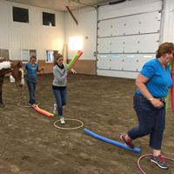
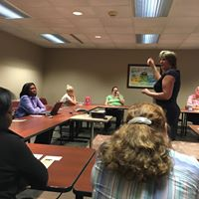

OTHERS
Notes:
Too Much Fun
Not talked to family 23 years
Presental UPS Global – not like anything else use to

Slide 21

The Solution is…
Think it
Focus forward
Support
Notes:
THIS IS THE SUPPORT SCREEN

Slide 22
Secret #1
You Can’t Get to Where You Want to Go Without First Thinking It.

Slide 23

Everything is Created Twice.
First in Thought, Then in Action.
Notes:
Let me share a story of a young man in his early years at school he describes himself as quiet and having no friends. He struggled for many years with a learning disability, dyslexia which in school he was considered disturbed and had behavior issues. It wasn't all downhill for Jim. First, he had to work around his learning disability, dyslexia, to succeed in school. He did this by developing a phenomenal memory.
Thank goodness hiss dad tended to encourage his craziness, his mom was alarmed and often sent him to his room. No problem - He loved practicing silly stuff in front of the mirror. He was great at making people laugh.
His family lived in a rough district with lots of low-rent townhouses. By the tenth grade he was trying to juggle eight-hour night shifts at the factory with school during the day. He was so exhausted that he couldn't understand what his teachers were talking about. He didn't have any friends at school and feared that anyone getting close might find discover his embarrassing poverty. With little learning and no relationships, he felt that school was getting him nowhere. He called it quits at 16.
His family decided that their surroundings were taking them the wrong direction, so they packed up and moved to Canada with no job in sight. His parents and two siblings lived in a beat-up yellow Volkswagen camper van for a full eight months, parking in campgrounds.
You can imagine his emotional baggage - the loss of his teen years, feeling intellectually backward, the embarrassment and hardship of poverty.
Over time he learned to use his hard times and set-backs to motivate him to try harder. He could have turned to drugs and drinking. Instead, he channeled his energies to making something special out of his life.
Through lots of life trial and error to make it, he ventured to Hollywood. He shares that thinking and believing was something he practiced often. He would drive up and sit in his car on top of the mountain, look out at the city, stretch out his arms, and say, “Everyone wants to work with me. I’m a good actor. I have all kinds of great movie offers.”
He would just repeat these things over and over, literally convincing himself that he had a couple of movies lined up. He’d drive down that hill, ready to take the world on, going, “Movie offers are out there for me, I just don’t hear them yet.”
Around 1990, when he was a struggling young Canadian comic trying to make his way in Los Angeles, he drove his old Toyota up to the top of the mountain. While sitting there looking at the city below and dreaming of his future, he wrote himself a check for $10 million, dated it Thanksgiving 1995, added the notation “for acting services rendered,” and carried it in his wallet from that day forth.
The rest, as they say, is history. He’s thinking and believing eventually paid off, and by 1995, after the huge box office success of Ace Ventura his first check was $10M Today after: Pet Detective, The Mask, and Dumb & Dumber and more his asking price had risen to $20 million per picture. You know this person to Jim Carey.

Slide 24
Secret #2
Focus Forward Regardless of Any Situation

Slide 25

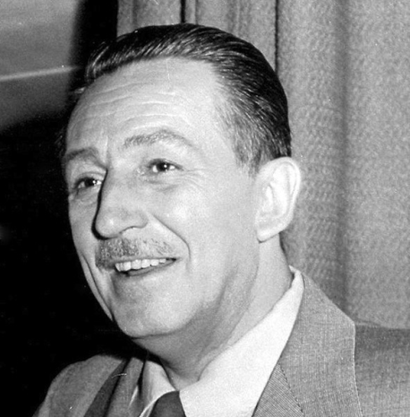
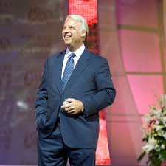
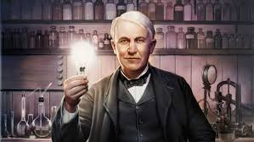

Focus
Forward
Notes:
It doesn’t matter where we come from, what education we have, what we’ve done. What matters is we continue to look at what we want from life and with determination to continue to look forward and focus on solution. Someone that set the stage for this and who I reference often and is an inspiration for me is Thomas Edison. Do you recall how many tries it took him before he invented the light bulb? 10,000
Ironically, Spielberg was rejected from the University of Southern California School of Theater, Film and Television three times. He was eventually accepted by another school, a school which he dropped out of to pursue directing. In 2002, Spielberg finally completed his BA. Where is he today?
K. Rowling was rejected by about 12 different publishers. What of Harry Potter?
Walt Disney was fired from a local newspaper, the Kansas City Star.
Apparently he "lacked imagination and had no good ideas." I think multiple generations of children will have something to say about that.
Jack Canfield, publishers rejected his crazy idea of “Chicken Soup of the Soul” 120 times. Today is written in 144 versions.
What did they all have? Solution focus or what I call Focus Forward.

Slide 26

Your Getting Stuck Because You’re Focusing on the Problem, Not the Solution.
Notes:
Tell Story – DO NOT TEACH! Didn’t talk to family - Argument

Slide 27
Secret #3
You Must Have CSA.
Commitment, Support
and Accountability
Notes:
Actor, Book, All had support -

Slide 28

It is Proven Over and Over Every New Years That Without Support, 98% of People Fail.
Notes:
NOTE: Tell Stories, Don’t Teach
Weight
Smoking
New Job

Slide 29

RESULTS
Relationships Reunited
Increased Income
Reaching Massive Goals
Freedom
Notes:
Bob – 17 years
Rob – Changed Career, increased income, speaking out, attracting clients
Goals – Parkensons
Goals – Boston Marathan
Freedom – Be yourself

Slide 30
Who This Has Worked For…
Stay Home Moms
Professionals
Coaches
Bankers
Sales Agents (Real Estate, Cars, Life, Health)
Executive Wealth Management
Young Adults

Slide 31
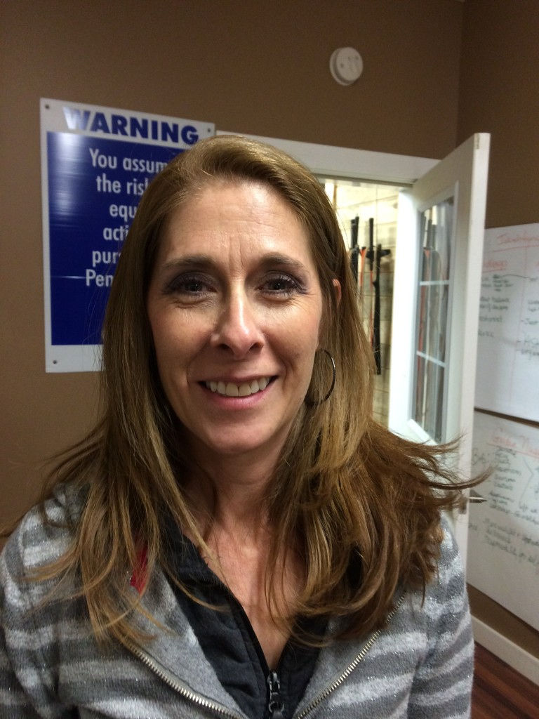
Testimonial…
“Harness Your Potential has given me hope for my future.
Gina and the horses have been teaching me how to let things go that need to be gone and they have taught me assertiveness and me my self-esteem to pursue my dreams and goals and it’s changing my life.”
Kerry P.
Notes:
SAMPLE TESTIMONIAL> _GINA NOTE – You can read more of her testimonial which isn’t featured but need to keep the amount of text on the page short. In the testimonials, you need to focus on results the people are getting and the one or two things where they are excelling at.
For her it’s letting things go and assertiveness. You get the idea

Slide 32

Time Well Spent?
Notes:
GINA NOTE - Ask the question here - Would you agree, this been time well spent

Slide 33

Dive Deeper
Impossible to Cover it all in an Hour Webinar (even if we had all day.)
Special Offer
Taking Action Gives Great Results – Act Fast

Slide 34
HARNESS YOUR POTENTIAL
Creating and Attracting the Life You’ve Always Wanted
and Never Knew How.

Slide 35
You’ll Be Thrilled… to know you can start NOW
Notes:
Just take notice for a moment, you been stuck or struggling. You know this is for you, and this is exactly what you need. Are you ready to dive deeper?

Slide 36

Dive Deeper

Slide 37
My Gift
1:1 Exclusive 30 Minute Personal
Strategy Call with Gina
($750 Value) NOTE: This Bonus For First 20 People Only

Slide 38
What Will You Get…
30 Minutes 1:1
Diving into creating results
Building steps to move you forward
Technique to release where your feeling stuck
7 Steps Guide to Harness Your Potential

Slide 39
If All This Did Was…
Reduce Stress, Would It Be Worth it…?
Overcome fear, Would It Be Worth It?
Rebuild relationships, Would It Be Worth It?
Increase your income, Would It Be Worth It?
Allow time for a vacation, Would it be Worth It?

Slide 40
I HAVE A FAVOR TO ASK
Support a innovative and new organization that helps children who are adopted, fostered, or adjudicated through teaching Life Skills and Leadership with Equine Partners.
Harness Your Success Foundation, founded 2016
3239 Pennay Hill Rd
Kingsley, PA 18826

Slide 41

Schedule your Call
From my web
“Book Gina”
or
http://www.yarcorteacres.com/personal-coaching/

