Slide 1
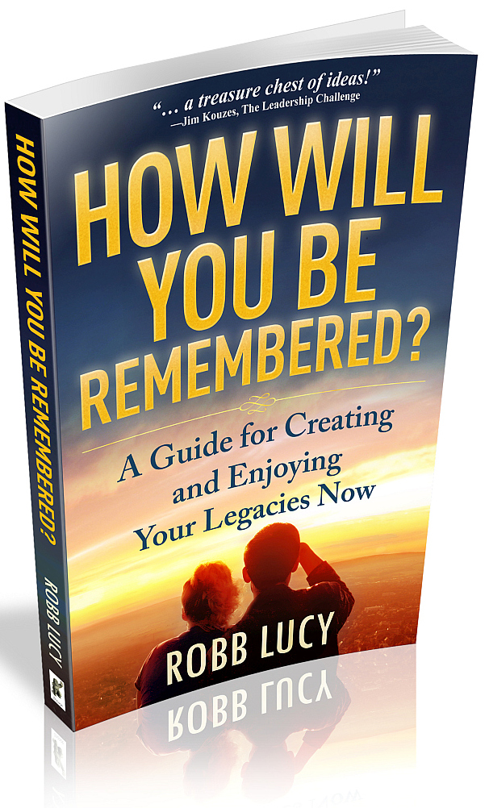
By: Robb Lucy
Journalist
Producer
Author
Teacher
Speaker
Notes:
Robb’s experience

Slide 2
… as an employee … as a boss
… as a leader
… as a career/executive coach
Notes:
Robb’s experience

Slide 3
Notes:
Robb’s experience

Slide 4
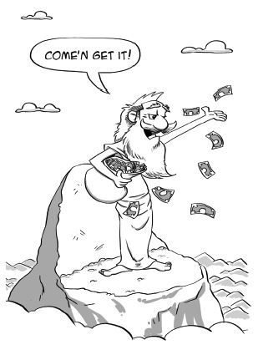
Legacy and Money

Slide 5
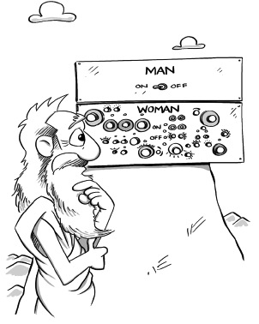
Legacy and Sex

Slide 6
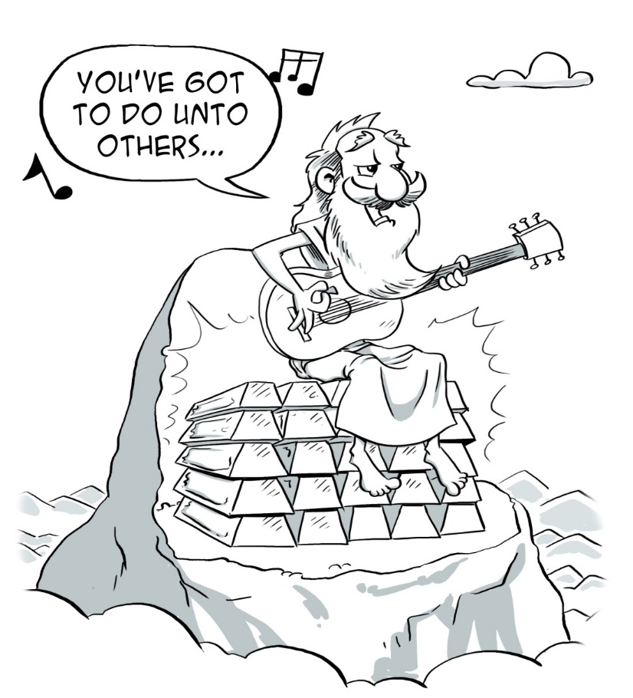
Legacy and Religion

Slide 7
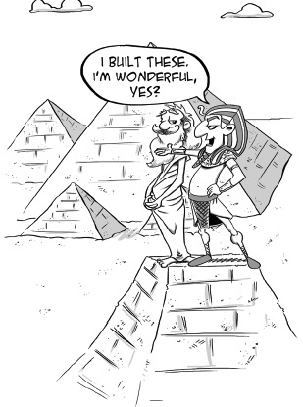
Legacy and Ego

Slide 8
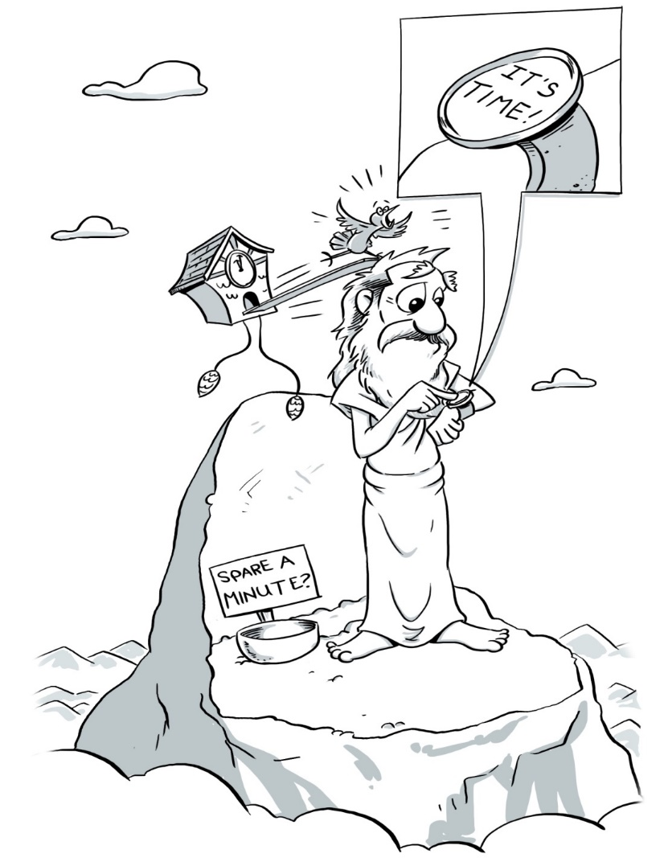
Legacy and Time

Slide 9
Legacy and Happiness
When were you most unhappy?
___ When I have unresolved conflict with others.
___ When I feel inertia – not using my skills/talents to give/create/move forward.
___ When I see the money’s running out.

Slide 10
Legacy and Happiness
When were you most unhappy?
56% When I have unresolved conflict with others.
32% When I feel inertia – not using my skills/talents to give/create/move forward.
12% When I see the money’s running out.

Slide 11
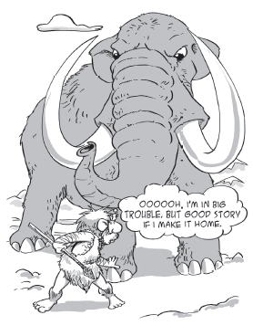
Legacy & Storytelling

Slide 12
Legacy & Storytelling
“Stories have to be told or they die.
And when they die, we can’t remember
who we are or why we’re here.”
Sue Monk Kidd,
The Secret Life of Bees

Slide 13
Legacy Definition

Slide 14
Legacy Definition
A legacy is something I create that:
Connects me to others… now
Enhances our lives… now
Makes me happy… now
Continue to positively affect others when I’m gone.
Don’t just leave a legacy.
LIVE your legacies!

Slide 15
3 ways to produce your Legacies:
____
1. Tell your Story
2. Gather their Stories
3. Create new Stories
______
______

Slide 16
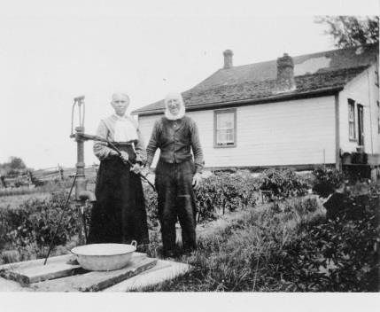
Legacy
Story
Method 1:
TELL your Story

Slide 17
Legacy
Story
Method 1:
TELL your Story
“What the next generation will value is not what we owned, but the evidence of who we were, and the tales of how we loved.”
Ellen Goodman

Slide 18
Legacy
Story
Method 1:
TELL your Story… with your VALUES
Accomplishment, Achievement, Acknowledgment, Adventure, Affluence, Ambition, Appreciation, Assertiveness, Balance, Beauty, Belonging, Bravery, Calmness, Candor, Care, Challenge, Charity, Cheerfulness, Clarity, Cleverness, Commitment, Community, Compassion, Competence, Competition, Conformity, Connection, Conservation, Contribution, Control, Cooperation, Courage, Creativity, Curiosity, Decisiveness, Determination, Devotion, Dignity, Diligence, Drive, Education, Efficiency, Empathy, Encouragement, Endurance, Entertainment, Environmentalism, Experience, Exuberance, Fairness, Faith, Fearlessness, Financial Independence, Fitness, Flexibility, Fortitude, Freedom, Friendliness, Generosity, Grace, Growth, Happiness, Health, Honesty, Humility, Humor, Imagination, Independence, Inspiration, Integrity, Intelligence, Joy, Kindness, Knowledge, Leadership, Love, Loyalty, Making a Difference, Meaning, Mindfulness, Modesty, Nature, Open-Mindedness, Opportunity, Optimism, Outdoors, Passion, Patience, Peace, Perceptiveness, Perseverance, Philanthropy, Playfulness, Pleasure, Pragmatism, Precision, Professionalism, Prosperity, Rationality, Recognition, Reflection, Reputation, Resourcefulness, Respect, Responsibility, Self-Reliance, Sensitivity, Sincerity, Spirituality, Spontaneity, Success, Synergy, Teaching, Teamwork, Tranquility, Trust, Truth, Uniqueness, Valor, Vision, Warmth, Wealth, Winning, Wisdom

Slide 19
Legacy
Story
Method 1:
TELL your Story… with your VALUES
Accomplishment, Achievement, Acknowledgment, Adventure, Affluence, Ambition, Appreciation, Assertiveness, Balance, Beauty, Belonging, Bravery, Calmness, Candor, Care, Challenge, Charity, Cheerfulness, Clarity, Cleverness, Commitment, Community, Compassion, Competence, Competition, Conformity, Connection, Conservation, Contribution, Control, Cooperation, Courage, Creativity, Curiosity, Decisiveness, Determination, Devotion, Dignity, Diligence, Drive, Education, Efficiency, Empathy, Encouragement, Endurance, Entertainment, Environmentalism, Experience, Exuberance, Fairness, Faith, Fearlessness, Financial Independence, Fitness, Flexibility, Fortitude, Freedom, Friendliness, Generosity, Grace, Growth, Happiness, Health, Honesty, Humility, Humor, Imagination, Independence, Inspiration, Integrity, Intelligence, Joy, Kindness, Knowledge, Leadership, Love, Loyalty, Making a Difference, Meaning, Mindfulness, Modesty, Nature, Open-Mindedness, Opportunity, Optimism, Outdoors, Passion, Patience, Peace, Perceptiveness, Perseverance, Philanthropy, Playfulness, Pleasure, Pragmatism, Precision, Professionalism, Prosperity, Rationality, Recognition, Reflection, Reputation, Resourcefulness, Respect, Responsibility, Self-Reliance, Sensitivity, Sincerity, Spirituality, Spontaneity, Success, Synergy, Teaching, Teamwork, Tranquility, Trust, Truth, Uniqueness, Valor, Vision, Warmth, Wealth, Winning, Wisdom

Slide 20
Legacy
Story
Method 1:
TELL your Story… with your VALUES
Integrity
Connection
Wisdom
Creativity
Joy
Now I can write my ‘Legacy Letter’

Slide 21
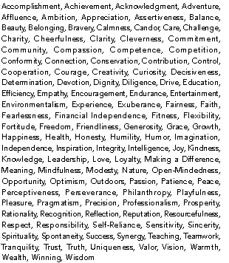
Legacy
Story
Method 1:
TELL your Story in a Legacy Letter
INTEGRITY:
Why is this Value important to me? ______________________________________________________ ______________________________________________________ ______________________________________________________
A Story of this Value in my life? ______________________________________________________ ______________________________________________________ ______________________________________________________

Slide 22

Legacy
Story
Method 1:
TELL your Story in a Legacy Letter
INTEGRITY:

Slide 23

Legacy
Story
Method 1:
TELL your Story in a Legacy Letter
INTEGRITY:

Slide 24

Legacy
Story
Method 1:
TELL your Story in a Legacy Letter
1. Integrity… the mountain
2. Connection … travel
3. Wisdom … listening
4. Creativity …turn around
5. Joy …MAW

Slide 25
Legacy
Story
Method 1:
TELL your Story in a Legacy Letter
Accomplishment, Achievement, Acknowledgment, Adventure, Affluence, Ambition, Appreciation, Assertiveness, Balance, Beauty, Belonging, Bravery, Calmness, Candor, Care, Challenge, Charity, Cheerfulness, Clarity, Cleverness, Commitment, Community, Compassion, Competence, Competition, Conformity, Connection, Conservation, Contribution, Control, Cooperation, Courage, Creativity, Curiosity, Decisiveness, Determination, Devotion, Dignity, Diligence, Drive, Education, Efficiency, Empathy, Encouragement, Endurance, Entertainment, Environmentalism, Experience, Exuberance, Fairness, Faith, Fearlessness, Financial Independence, Fitness, Flexibility, Fortitude, Freedom, Friendliness, Generosity, Grace, Growth, Happiness, Health, Honesty, Humility, Humor, Imagination, Independence, Inspiration, Integrity, Intelligence, Joy, Kindness, Knowledge, Leadership, Love, Loyalty, Making a Difference, Meaning, Mindfulness, Modesty, Nature, Open-Mindedness, Opportunity, Optimism, Outdoors, Passion, Patience, Peace, Perceptiveness, Perseverance, Philanthropy, Playfulness, Pleasure, Pragmatism, Precision, Professionalism, Prosperity, Rationality, Recognition, Reflection, Reputation, Resourcefulness, Respect, Responsibility, Self-Reliance, Sensitivity, Sincerity, Spirituality, Spontaneity, Success, Synergy, Teaching, Teamwork, Tranquility, Trust, Truth, Uniqueness, Valor, Vision, Warmth, Wealth, Winning, Wisdom

Slide 26
Legacy
Story
Method 1:
TELL your Story in a Legacy Letter
In your Legacy Letter –
for each Value:
Why is this Value important to me? ______________________________________________________ ______________________________________________________ ______________________________________________________
A story of this Value in my life? ______________________________________________________ ______________________________________________________ ______________________________________________________

Slide 27

Legacy:
1. Tell your Story
2. Gather their Stories
3. Create new Stories
___
___
___

Slide 28
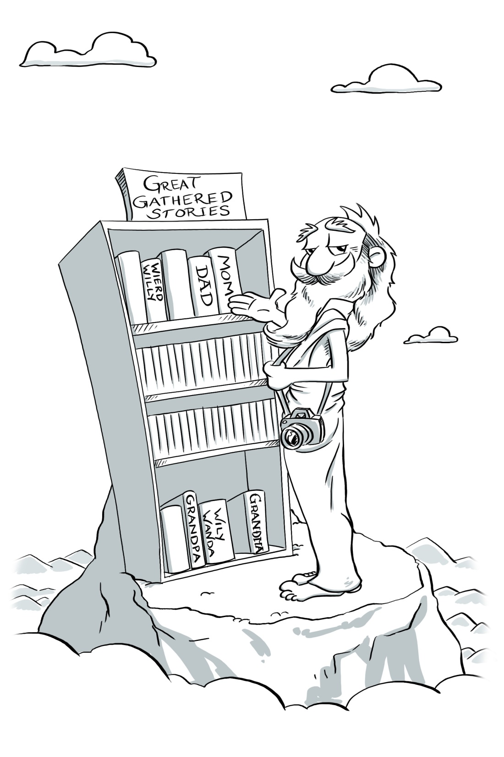
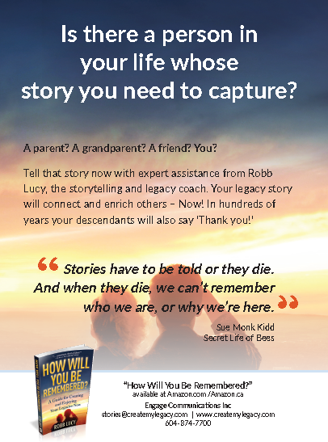
Legacy
Story
Method 2:
GATHER their Story.

Slide 29
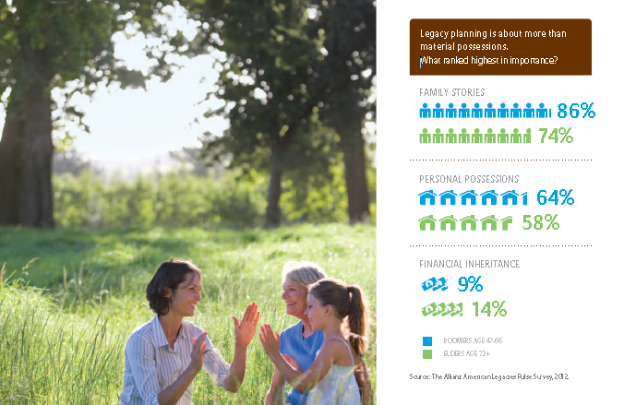
Legacy
Story
Method 2:
GATHER their Story.

Slide 30
Legacy
Story
Method 2:
GATHER their Story.
“My mother told me the other day that there’s a lot she’d like to know, but there’s nobody left to ask. The door to the past is closed.”
Garrison Keiller

Slide 31
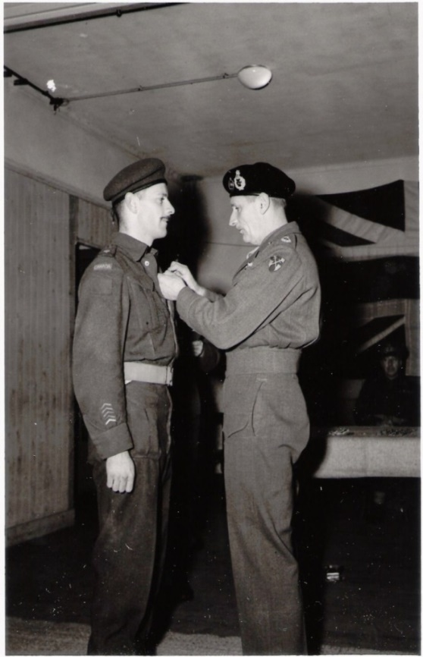
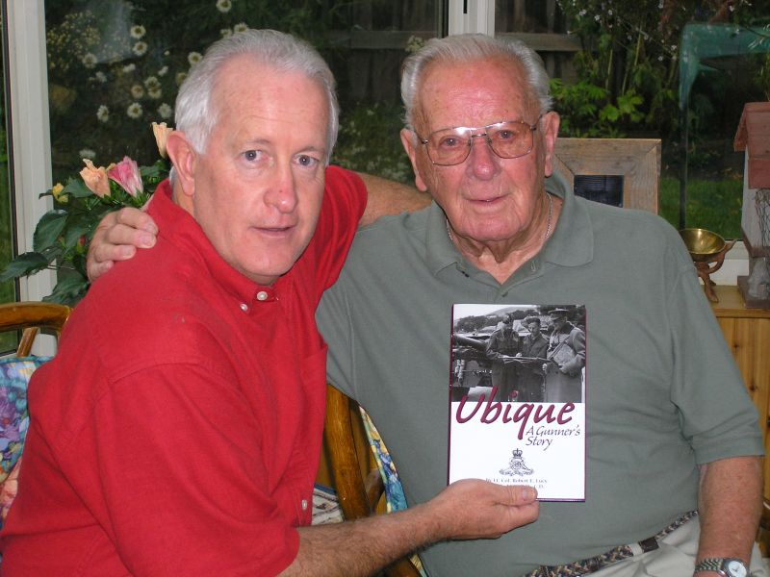

Legacy
Story
Method 2:
GATHER their Story.

Slide 32
Legacy
Story
Method 2:
GATHER their Story.
Dangerous excuses for NOT Gathering
NO… Time
NO… Skills
NO… Story
NO… Techy
No… one will care!

Slide 33


Legacy
Story
Method 2:
GATHER their Story.

Slide 34
Legacy
Story
Method 2:
GATHER their Story.
“There was never yet an uninteresting life. Such a thing is an impossibility. Inside the dullest exterior there is a drama, a comedy and a tragedy.”
Mark Twain

Slide 35
Legacy
Story
Method 2:
GATHER their Story.
Your ONE question to gather their stories:
“Tell me about…”

Slide 36
LEGACY
1. Tell your Story
2. Gather their Stories
3. Create new Stories

Slide 37
Legacy
Story
Method 3:
CREATE new Stories.

Slide 38
Legacy
Story
Method 3:
CREATE new Stories.
Significant strengths
+
Imagination
A Legacy

Slide 39
Talent/Skill
Legacy
Story
Method 3:
CREATE new Stories.
Your Legacy

Slide 40
Talent/Skill
Legacy
Story
Method 3:
CREATE new Stories.
Your Legacy
Gardening

Slide 41
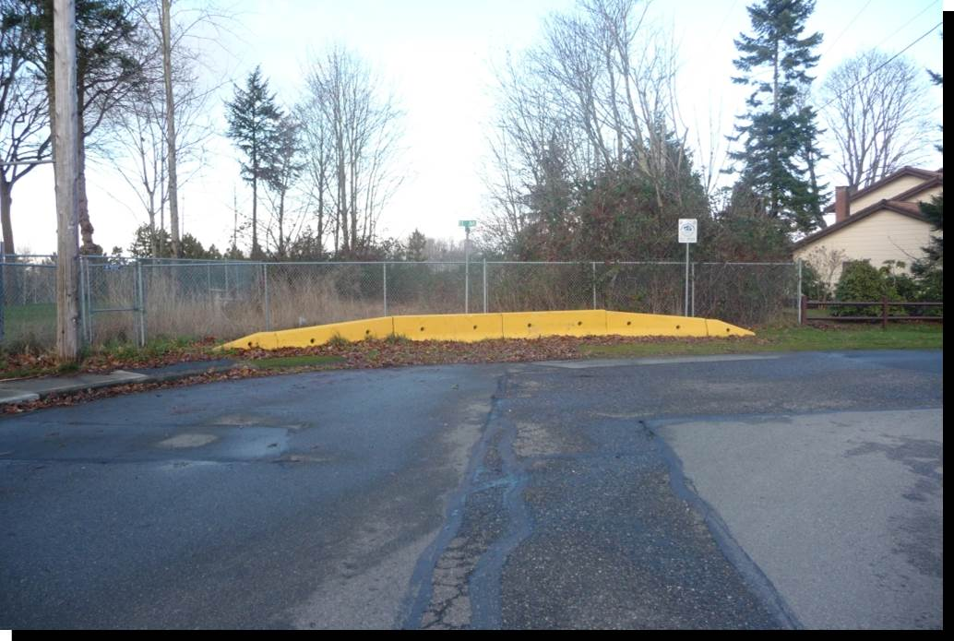
Talent/Skill
Legacy
Story
Method 3:
CREATE new Stories.
Your Legacy
Gardening

Slide 42

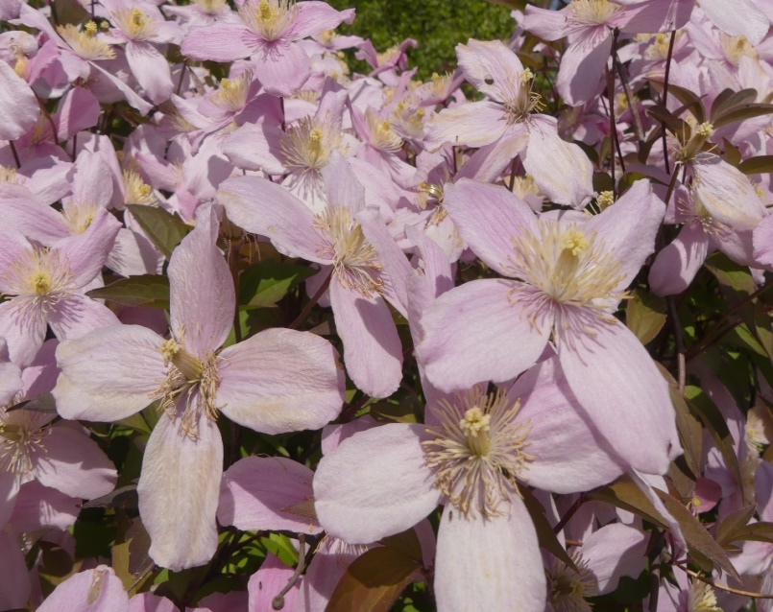

Talent/Skill
Legacy
Story
Method 3:
CREATE new Stories.
Your Legacy
Gardening
Legacy Garden

Slide 43
“Don’t part with your illusions. When they’re gone, you may still exist, but you have ceased to live.” Mark Twain
Legacy
Story
Method 3:
CREATE new Stories.

Slide 44

Talent/Skill
Legacy
Story
Method 3:
CREATE new Stories.
Value
Legacy

Slide 45
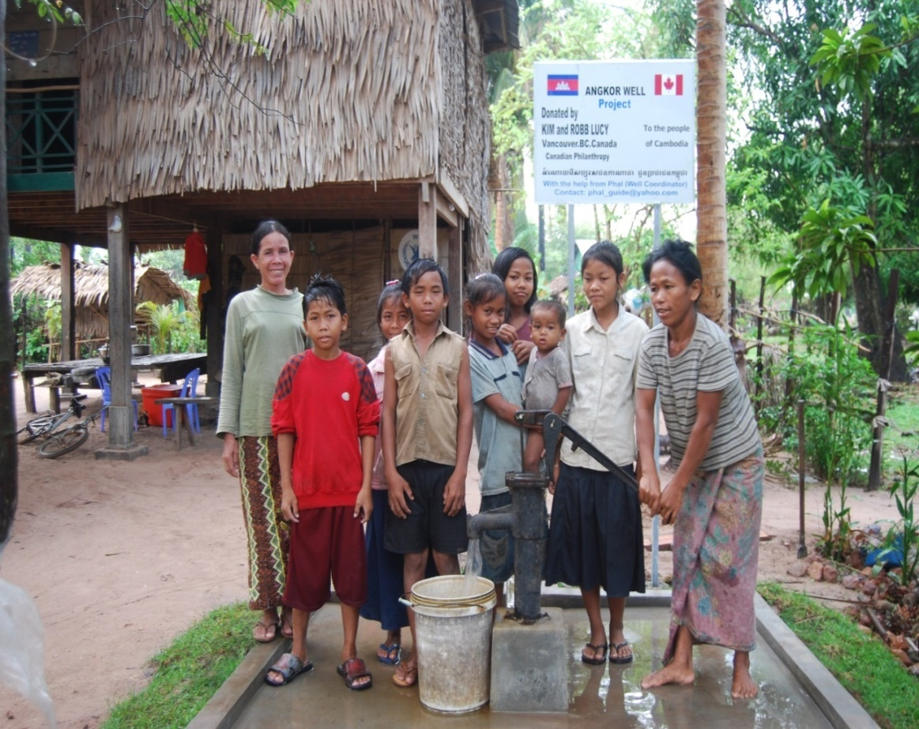
Talent/Skill
Legacy
Story
Method 3:
CREATE new Stories.
Value
Legacy
Opportunity Research Healthy people
Brighter Future

Slide 46
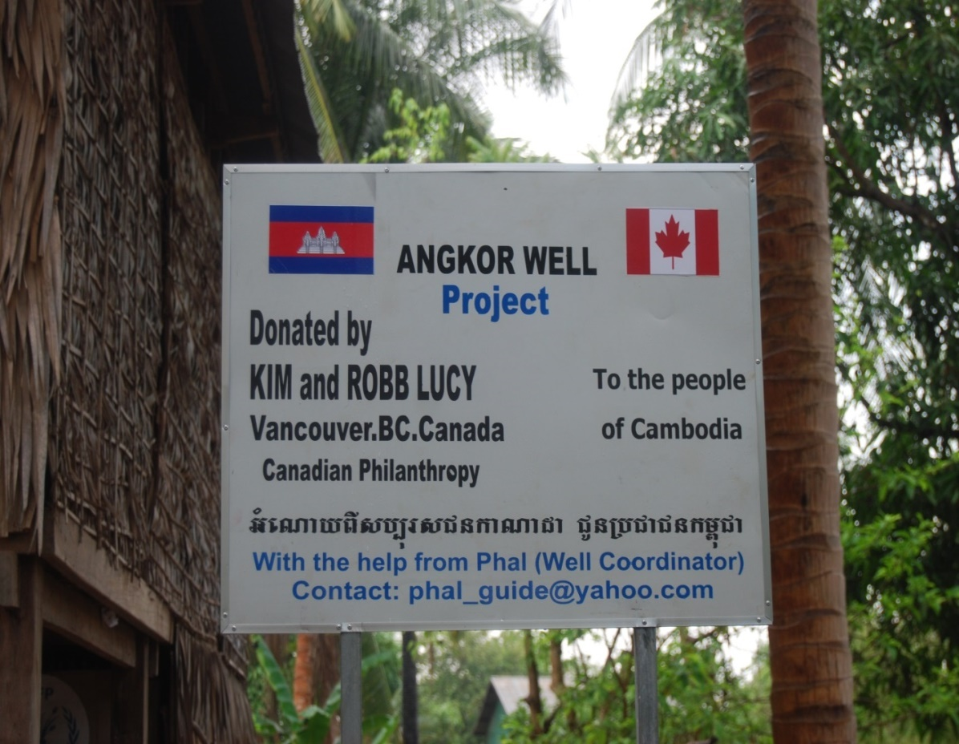
Talent/Skill
Legacy
Story
Method 3:
CREATE new Stories.
Value
Legacy
Opportunity Research Healthy people
Brighter Future

Slide 47
Talent/Skill
Legacy
Story
Method 3:
CREATE new Stories.
Value
Legacy
Giving back Story telling

Slide 48



Talent/Skill
Legacy
Story
Method 3:
CREATE new Stories.
Value
Legacy
Giving back Story telling Make-A-Wish

Slide 49

Tell your Story
Gather their Stories
Create new Stories

Slide 50
New Podcast:
legacycafe.org
The book:
createmylegacy.com
Email:
rlucy@createmylegacy.com

Slide 51
New Podcast:
legacycafe.org
The book:
createmylegacy.com
Email:
rlucy@createmylegacy.com

